Slide 1


Employer MyBenefits Portal Tutorial
NEW HIRE- Basic Life Only Batch (Multiple Entries)

Slide 2
Before You Begin
2 of 16
Helpful Tip
Gather all employee information before starting. Having everything ready will make the upload process faster and help prevent errors.
Before starting a New Hire transaction, please review the following information:
New Hire – Basic Life transactions can be entered any time during the year.
Coverage is effective the first day of the month following the employee's hire date and should coincide with payroll deductions.
Retroactive effective dates cannot be entered online.
Complete one transaction at a time.

Slide 3
Before You Begin
3 of 16
Helpful Tip
Bookmark the Employer Portal login page for quicker access in the future.
You must be logged into the NMPSIA MyBenefits Portal before
completing this tutorial.
If you are a new user, forgot your password, or experience login issues, please refer to the Employee Login Tutorial https://nmpsia.com/employer-trainings.html for complete step-by-step instructions.
Important Reminders
• MFA codes expire after 5 minutes.
• Use the email associated with your NMPSIA benefits.
• Check your Spam or Junk folder if you do not receive your code.
Need help logging in?
Please refer to the Employer Login Tutorial before continuing.
The Employer Login Tutorial includes:
✔ First-Time Login
✔ Password Assistance
✔ MFA Verification
✔ Common Login Errors
✔ Account Assistance
Go to NMPSIA.com
↓
Benefits Portal Login
↓
Select Employer
↓
Enter District ID
↓
Select Representative
↓
Enter Password
↓
Complete MFA Verification

Slide 4
What You'll Need
4 of 16
Helpful Tip
Verify you have all information before beginning.
Before beginning, have the following information available:
District ID
Your login credentials
Access to your authentication email
Employee Demographics
Employee Salary, Hire Date, Job Title, and Number of Hours

Slide 5
Transaction Overview
5 of 16
Helpful Tip
Every Employer Portal transaction follows the same basic process:
→ Enter → Review → Submit → Verify
Although each transaction may require different information, the overall process remains consistent throughout the Employer Portal.
This tutorial will show you how to:
Enter all required employee information
Review the transaction for accuracy
Submit the transaction for processing
Verify that the transaction was successfully submitted
Understand what happens after submission

Slide 6
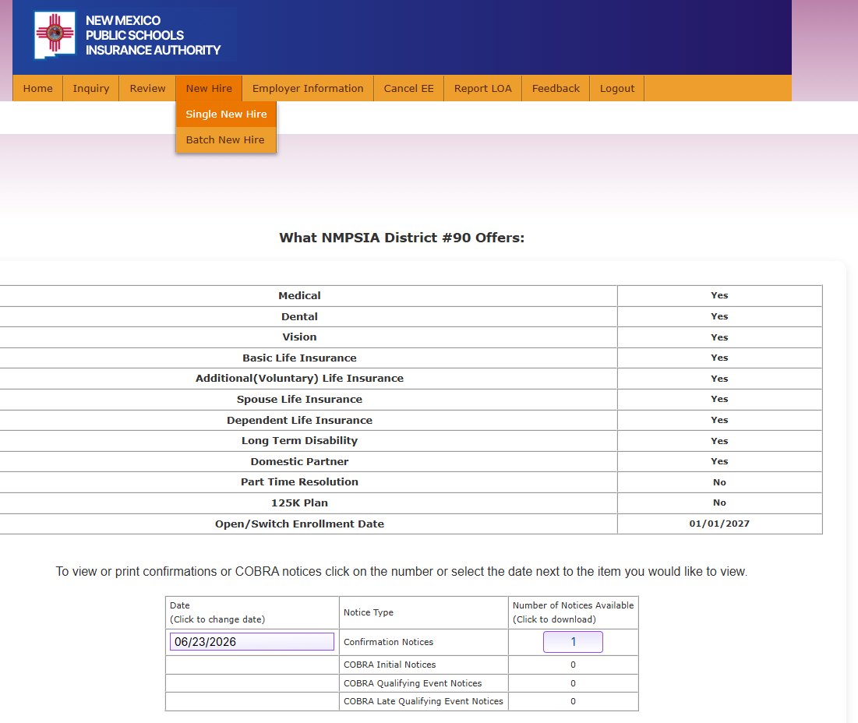
Step 1
6 of 16
From the Home page
Navigate to the New Hire tab.
Choose Batch New Hire

Slide 7
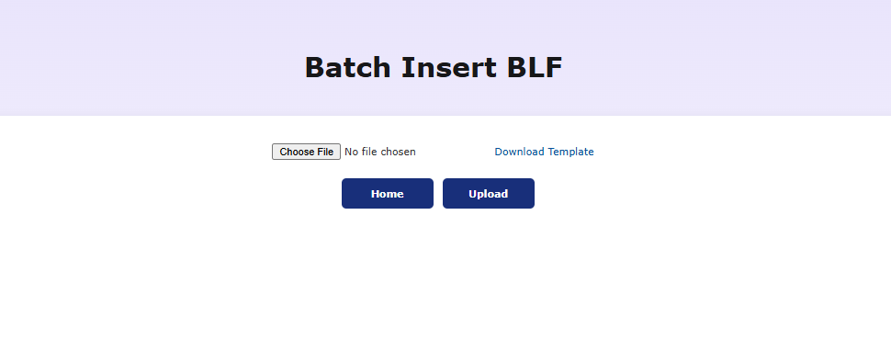
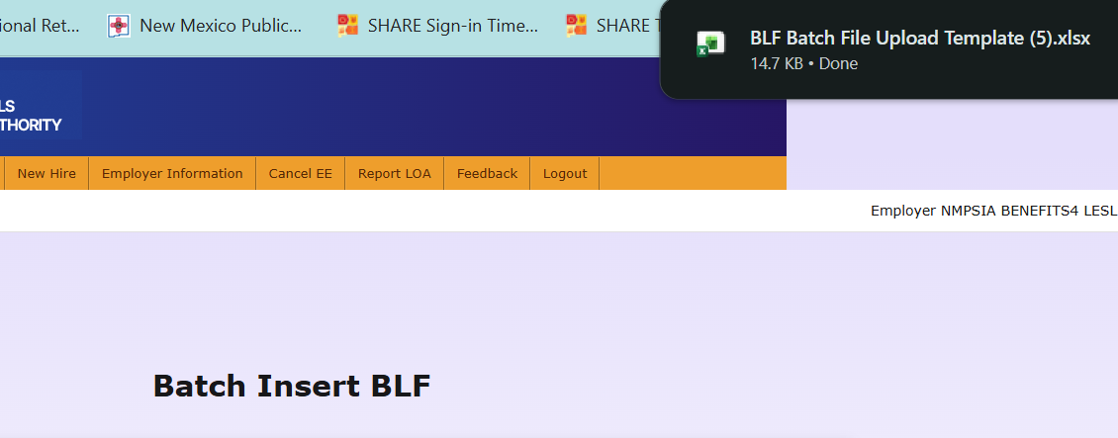
Step 2
7 of 16
1. Select Download Template
  The file template will download to your computer
2. Click on the file to open
1
2
Helpful Tip
Always download a new template from the portal. Using an older template may cause upload errors if the format has changed.

Slide 8
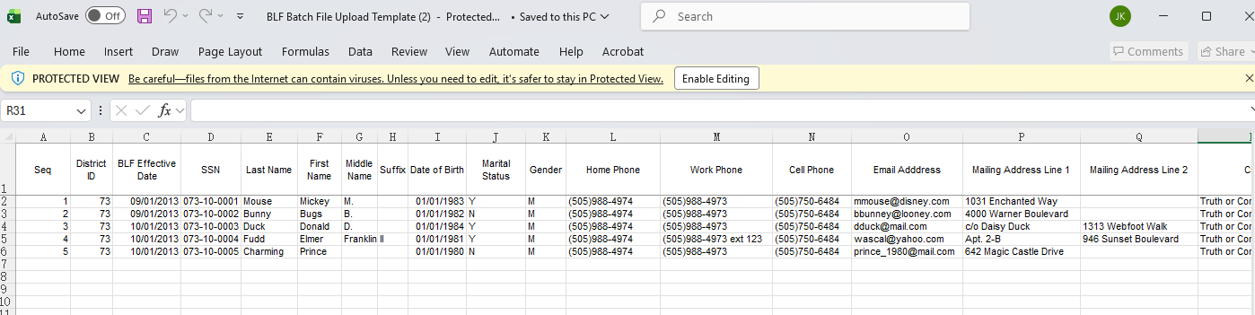
Step 3
8 of 16
Select Enable Editing to optimize user experience.
Review the sample information provided.
All entries must follow the format shown to ensure the information can be processed accurately and efficiently.
Enter the required information for each New Hire you wish to add to Basic Life coverage in the cells below the sample entries.
Delete the sample information before saving your file. Do not change the column headings or the structure of the spreadsheet.
To save your work, navigate to File > Save As.
Name the file using the following naming convention: schooldistrict/entity.newhires.monthyear
  Example: NMPSIA.newhires.May2024
Helpful Tip
Complete every required field exactly as requested. Double-check spelling, dates, and Social Security Numbers before saving.
5
1
2
3

Slide 9
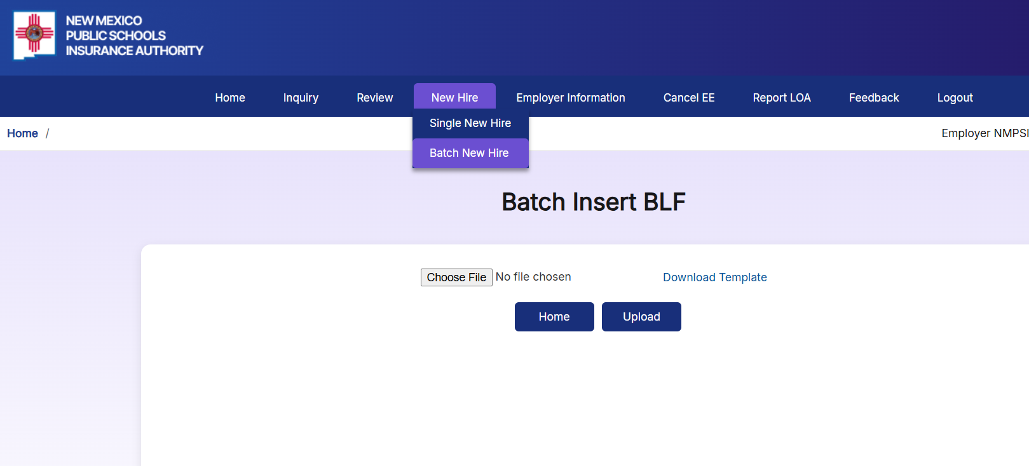
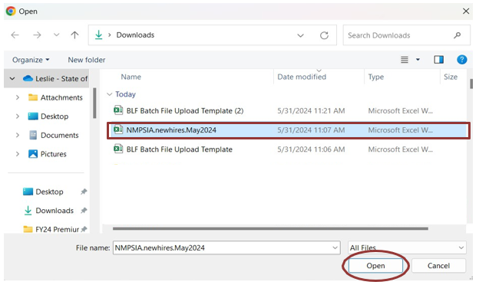
Step 4
9 of 16
If needed, navigate back to the MyBenefits Portal > Batch New Hire tab
Select Choose File
Select your file from your computer
Click Open
1
2
Helpful Tip
Save and Close the spreadsheet before uploading. An open Excel file may cause an unsuccessful upload.
3

Slide 10
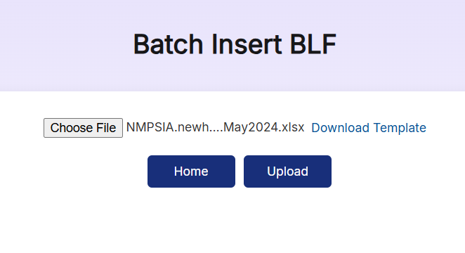
Step 5
10 of 16
Verify your file is displayed near Choose File
Select Upload
1
2
Helpful Tip
After selecting Upload, allow the system a few moments to process your file. Avoid clicking Upload multiple times.

Slide 11
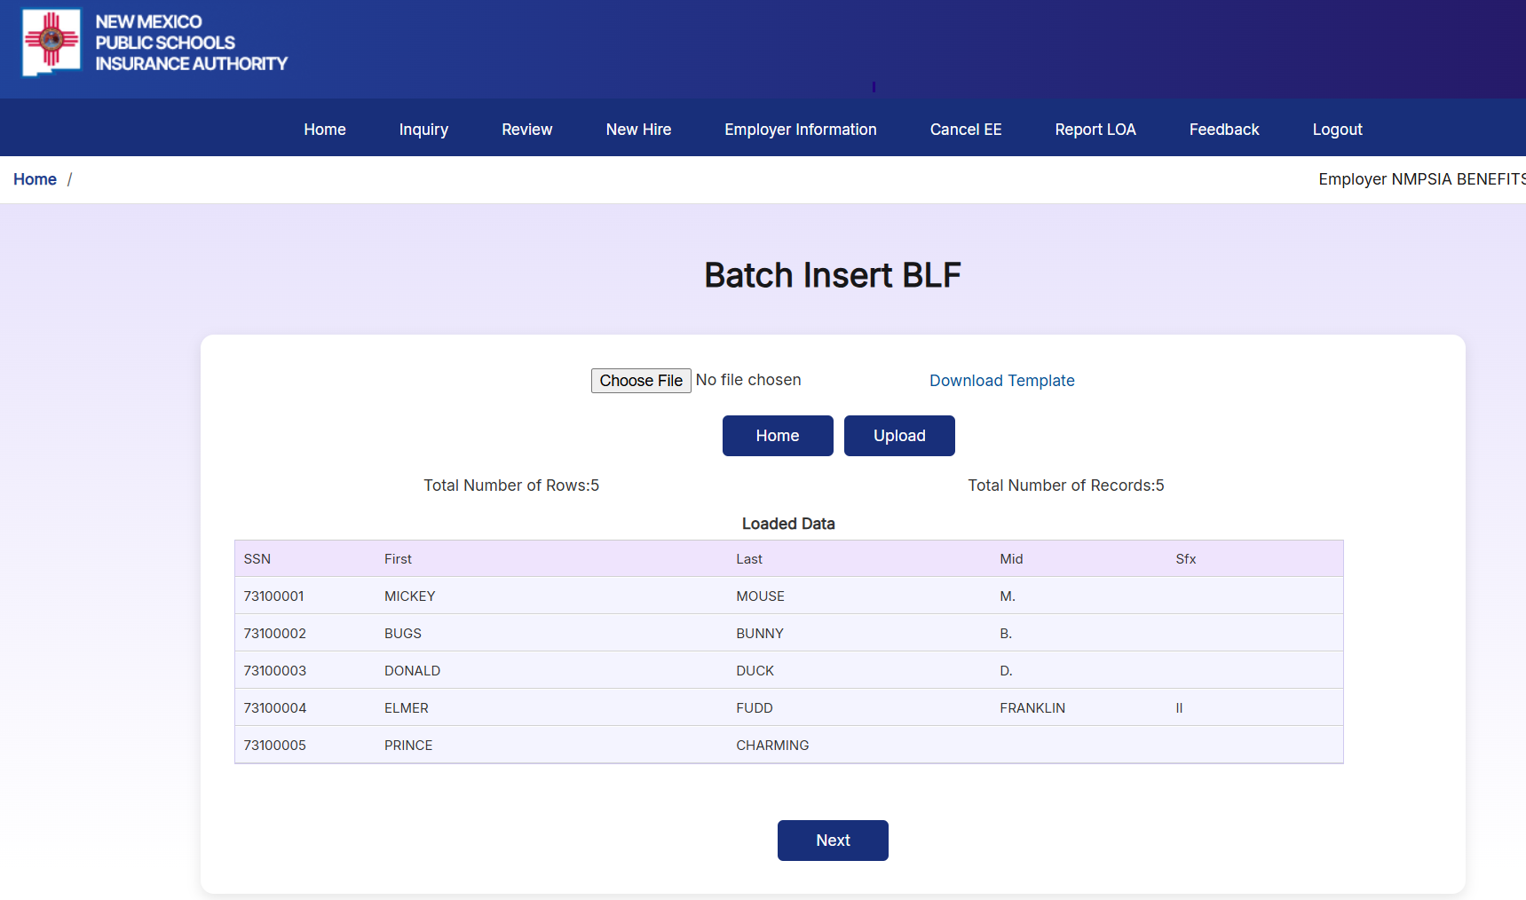
Step 6
11 of 16
Verify the number of records is correct
Verify the employee information is correct
Select Next
1
Helpful Tip
Carefully review every employee before continuing. This is your last opportunity to identify errors before submission.
2
3

Slide 12
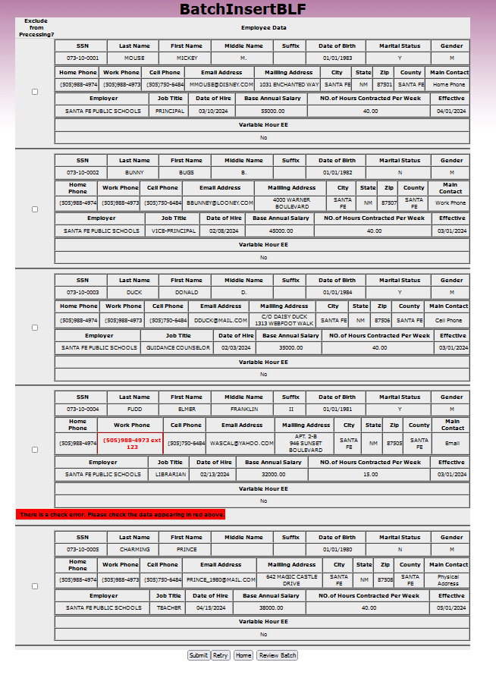
Step 7
12 of 16
Verify the employee information is correct
Errors will show in red text
  Click on the box to the left to exclude that entry from processing
If no errors, select Submit
Helpful Tip
Employees highlighted in red contain errors that must be excluded before proceeding. Excluded employees can be corrected and submitted later.

Slide 13
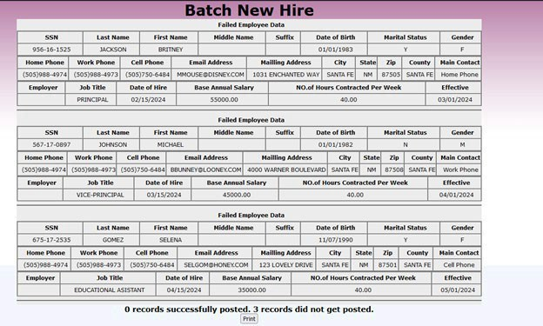
Step 8
13 of 16
Note: Once submitted, you can print this summary for your records.
Helpful Tip
Print or save the confirmation page for your records. It provides documentation that your batch was successfully submitted.

Slide 14
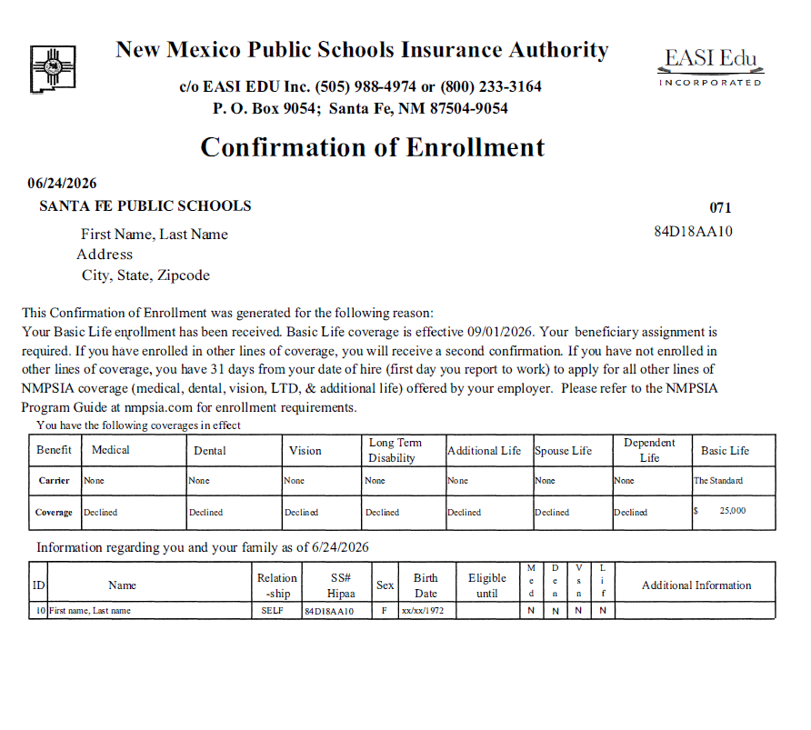
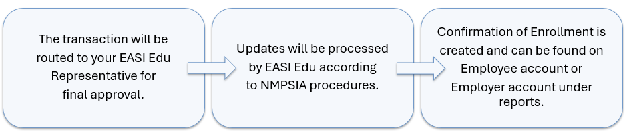
After Submission
14 of 16
Helpful Tip
Verify all information is correct, distribute to employee or print for employee file if needed.

Slide 15
Common Errors
15 of 16
Invalid Effective Date – Verify the effective date is correct and meets NMPSIA eligibility requirements before submitting the transaction.
Missing Required Information – Make sure all required fields are complete.
Invalid Date Format – All date entries must be entered as MM/DD/YYYY.
Duplicate Employee – If an employee is already enrolled in Basic Life coverage, this error will populate to notify you to exclude from processing.
Spreadsheet Left Open – Save and Close the spreadsheet before uploading. An open Excel file may cause an unsuccessful upload.
Wrong Template Used – Always download a new template from the portal.
Helpful Tip
If an error continues, contact your EASI Edu Administrative Representative.

Slide 16
Need Assistance
16 of 16
Thank you for supporting your employees!
Contact Us:
EASI Edu
Phone: 1-800-233-3164
Contact your assigned representative for portal assistance.
Or
NMPSIA Benefits Team
Phone: 1-800-548-3724

